Slide 1
Multiple Linear Regression Model in R
Procedures used:
Forward Regression with BIC <= Best model
Forward Regression with AIC <= Poor Performing model
Backward Regression with BIC <= Second Best model
Backward Regression with AIC <= Poor Performing model

Slide 2
Multiple Linear Regression Model in R
Data Cleaning:
Categorical variables in the Train data set have NAs that represent a factor of ‘None’ => converted to ‘None’
Categorical variables in the Test data set have NAs that were imputed primarily using mode, or frequency of occurrence
Caret library was used for imputing the numerical variables using KNN (K Nearest Neighbors) method in the Train data set, K = 38
The numerical data in Test was imputed using KNN imputation from the Training data as a base

Slide 3
Multiple Linear Regression Model in R
Feature Engineering and Data Transformations:
Corrected for skewness in the dependent variable Sale Price: log transformation was used
Corrected for a right skewed data distribution: the independent variables were transformed using sqrt(x), as log 0 is undefined
KNN imputation in R included scaling (standardization) of all of the numerical variables
Like variables such as Condition1, Condition2, and Exterior1, Exterior2 were combined

Slide 4
Multiple Linear Regression Model in R
Feature Engineering and Data Transformations (Cont’d):
Additional levels were added and grouped for categorical variables in the Test data set, to make them aligned to the Trained data set
YrsAge and RemodeledYrs were created from YearBuilt, YrSold & YearRemodAdd variables
Variables that are correlated to the feature engineered variables or that are redundant were dropped
Categorical variables were dummified in the regression model

Slide 5
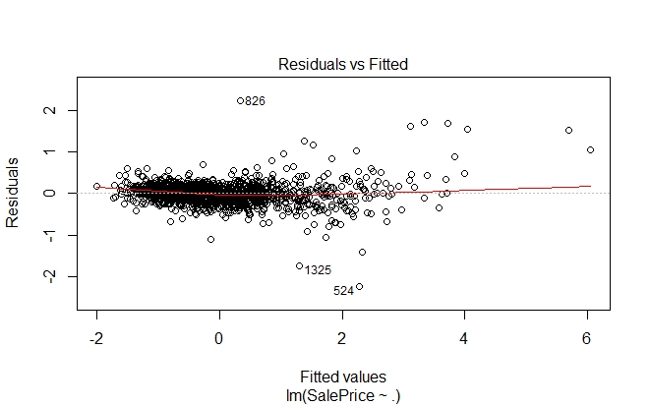
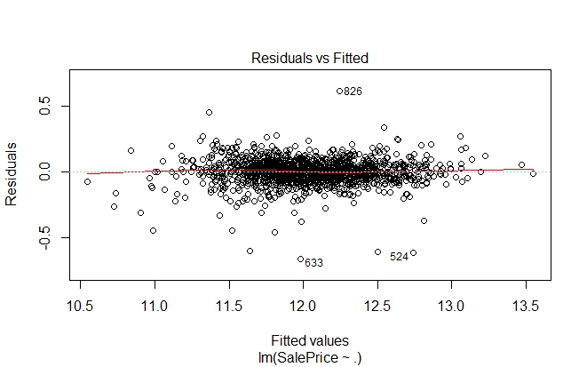
Multiple Linear Regression Model in R
Feature Engineering Outcomes (Linearity):
Before Transformations After Transformations

Slide 6
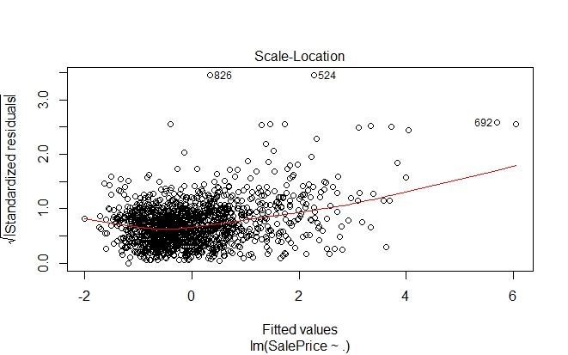
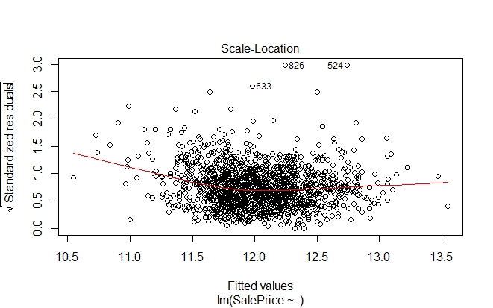
Multiple Linear Regression Model in R
Feature Engineering Outcomes (Constant Variance):
Before Transformations After Transformations

Slide 7
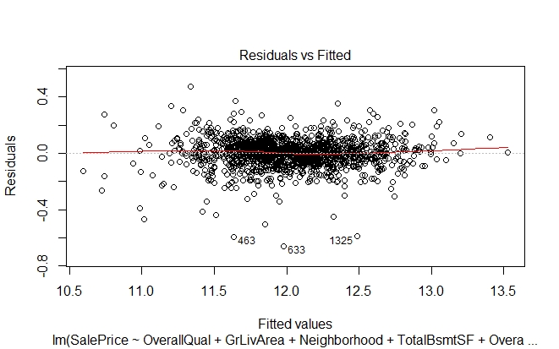
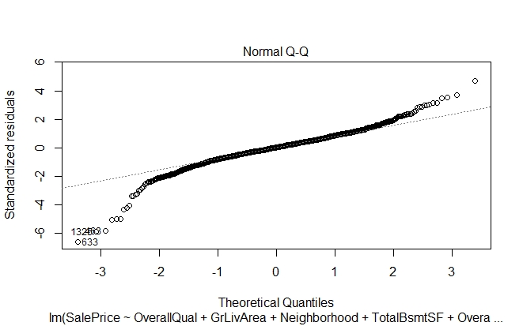
Multiple Linear Regression Model in R
Forward Stepwise Model Selection (BIC) on Full Train Data:

Slide 8
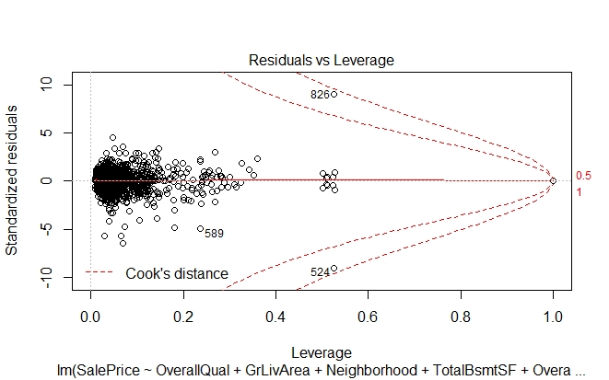
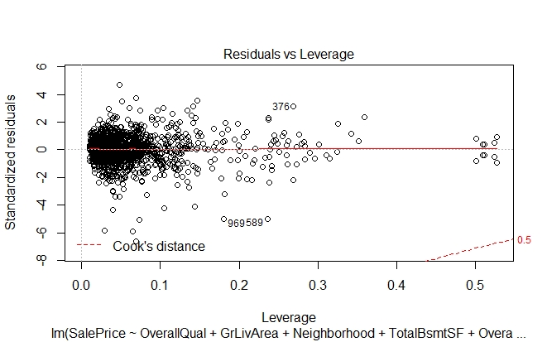
Multiple Linear Regression Model in R
Forward Stepwise Model Selection (BIC) on Full Train Data:
Removal of Outliers

Slide 9
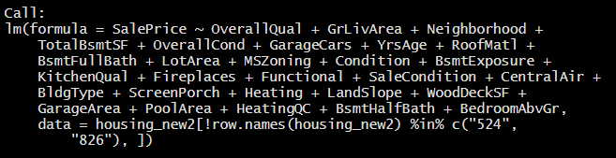

Multiple Linear Regression Model in R
Forward Stepwise Selection (BIC) Model Outcome:
Particularly significant to the model are these variables:
Overall Quality, Above Grade Living Area SF, Neighborhoods of Crawford and Sommerset, Roof Material, Sale Condition, and Kitchen Quality, all of which in higher qualities, increases the Sale Price on average.
Single Family Detached homes
on average, are valued much more
than Townhouses or Duplex homes

Slide 10
Multiple Linear Regression Model in R
Model Selection and AIC, BIC Criteria Comparison of Outcomes:
Kaggle Submission Scores
Forward Selection BIC | Backward Selection BIC | Forward Selection AIC | Backward Selection AIC | Forward Selection BIC (Data Split on Train 70%)
0.12487 | 0.12507 | 0.16089 | 0.16284 | 0.13065
BIC shows better prediction outcomes for the house prices data set, likely because the number of variables relative to the number of observations is large.
However, more observations can lead to a better prediction accuracy, as is shown here with a lower score when the observations are limited to a reduced training / test split data set.
K-fold cross validation with hyper parameter tuning can be used to better evaluate the model.

